Slide 1


Tesla business process review and Tuskla Web Site creation
Jason Gardner N01480000
Patrick Nelson N00158428
Joe O’Connor N00081799

Slide 2

Tesla Business Process and Business Model Review

Slide 3
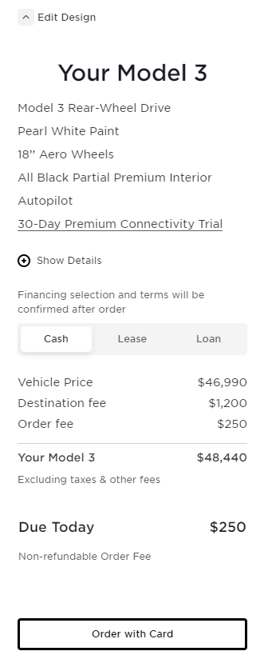
Project
Create a modern web site emulating Tesla using:
HTML
CSS.
.NET
A starter implementation based on a fictitious Sports Store model Provided by Our Professor
Initial Challenges
Sports Store Model Represented a Demonstration of the Technologies
The site must support a traditional shopping cart as well as vehicle purchases that represent multiple items.
Full shopping cart functionality
Admin functions to create/edit/delete/update admin users, products and orders

Slide 4
Design Challenges
Database Operations
Referential Integrity
Aggregation/Composition
Technologies
Subset of .NET/HTML/CSS
Time Constraints
Design
No Graphics Designers
No UI Designers

Slide 5

Technology Incorporated
.NET
HTML/CSS
External Libraries
Bootstrap
JQuery
Font-Awesome
JavaScript
GitHub
JSON
LINQ/MSSQL

Slide 6
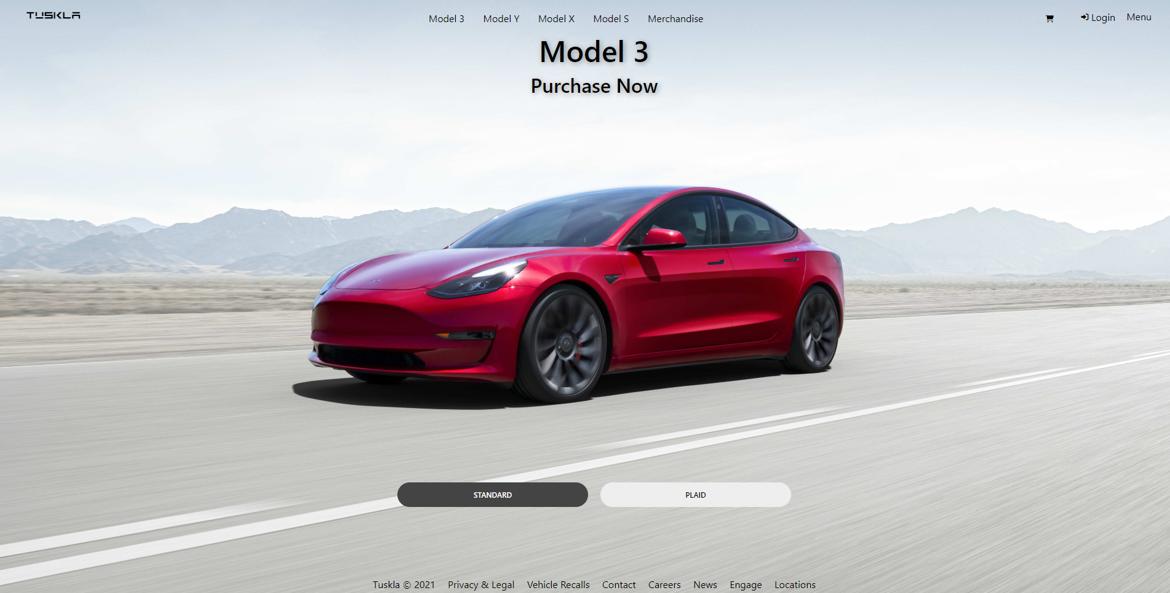
Home Page
Select Model

Slide 7
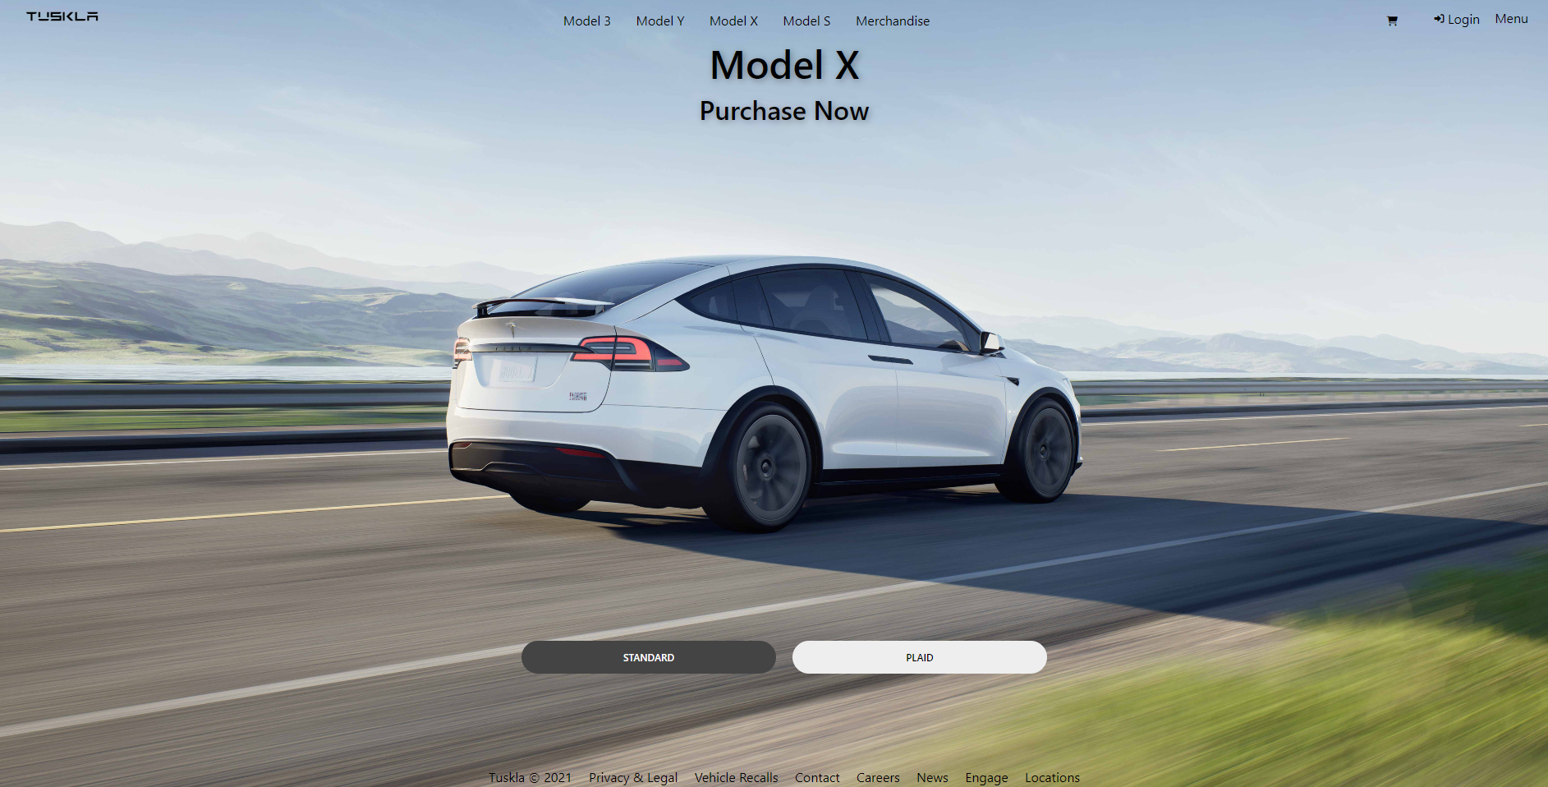
Select Model
Standard Model
Plaid Model

Slide 8
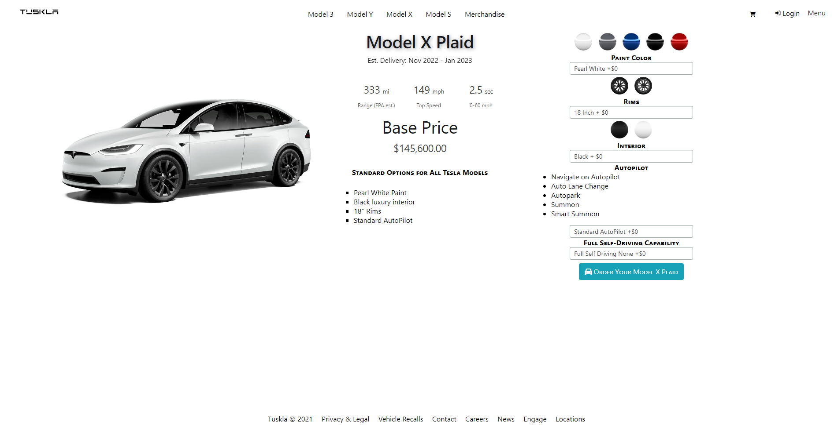
Vehicle Configuration
Vehicle Information Retrieved Via JSON
Vehicle Options Retrieved Via LINQ
Add Vehicle To Cart

Slide 9
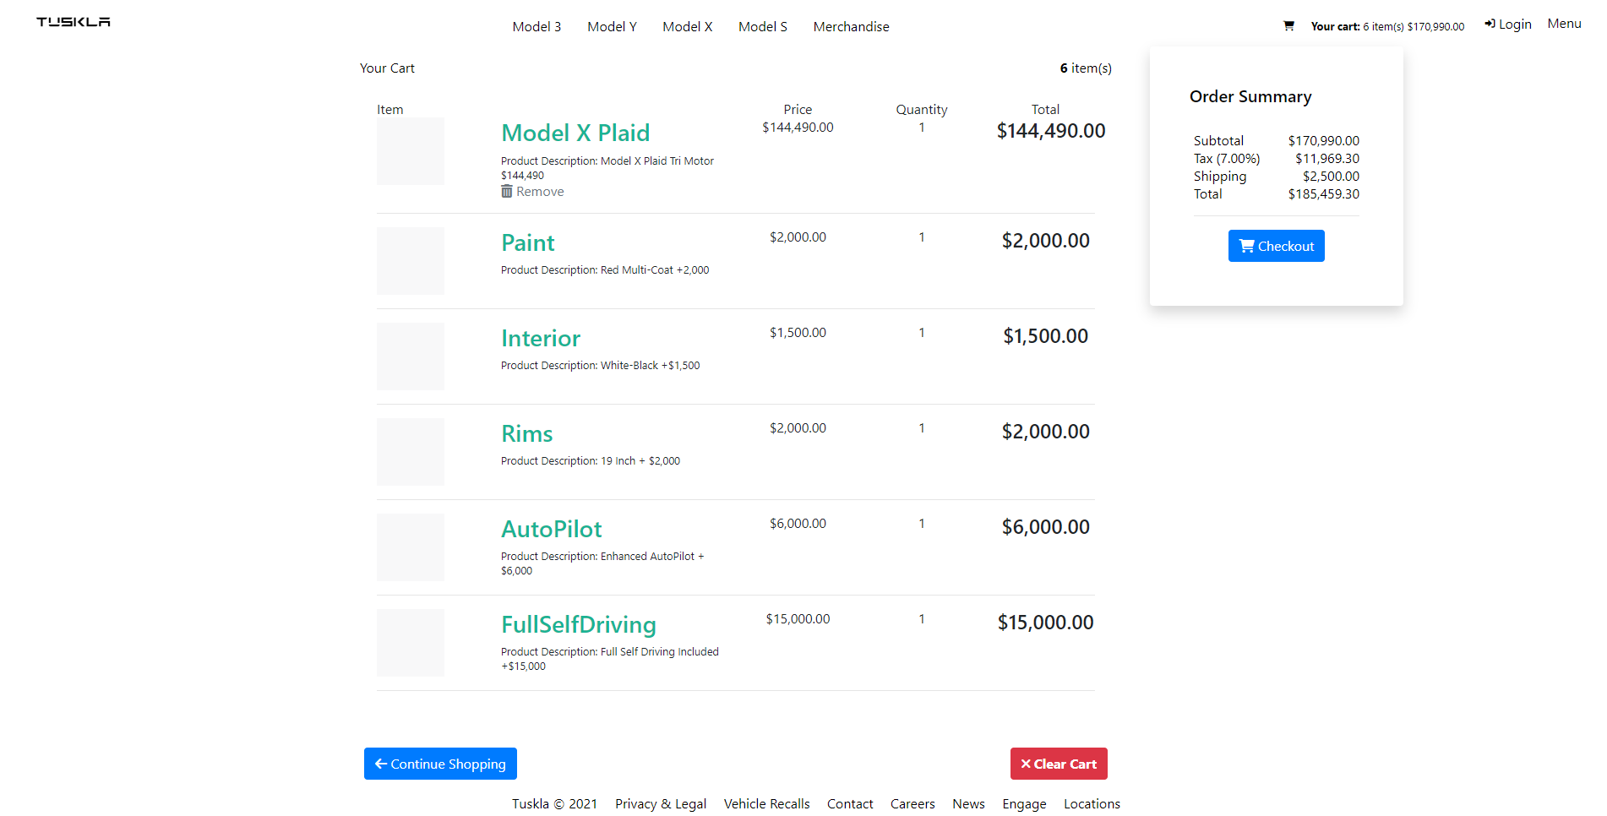
Shopping Cart
Continue Shopping
Order Summary
Shipping Calculation
Begin Checkout

Slide 10
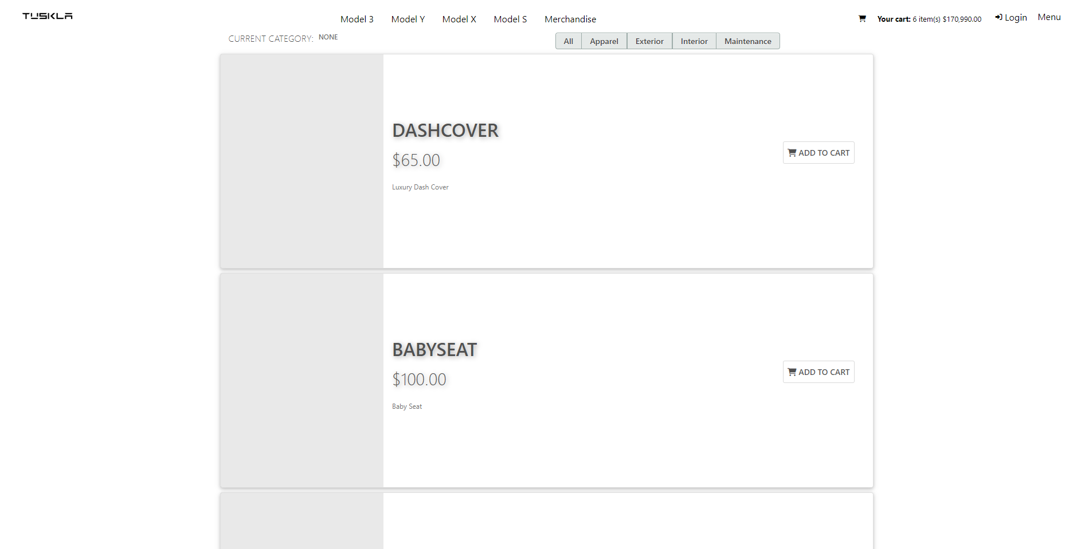
Merchandise Shop
Add Merchandise and Accessories to the Cart

Slide 11
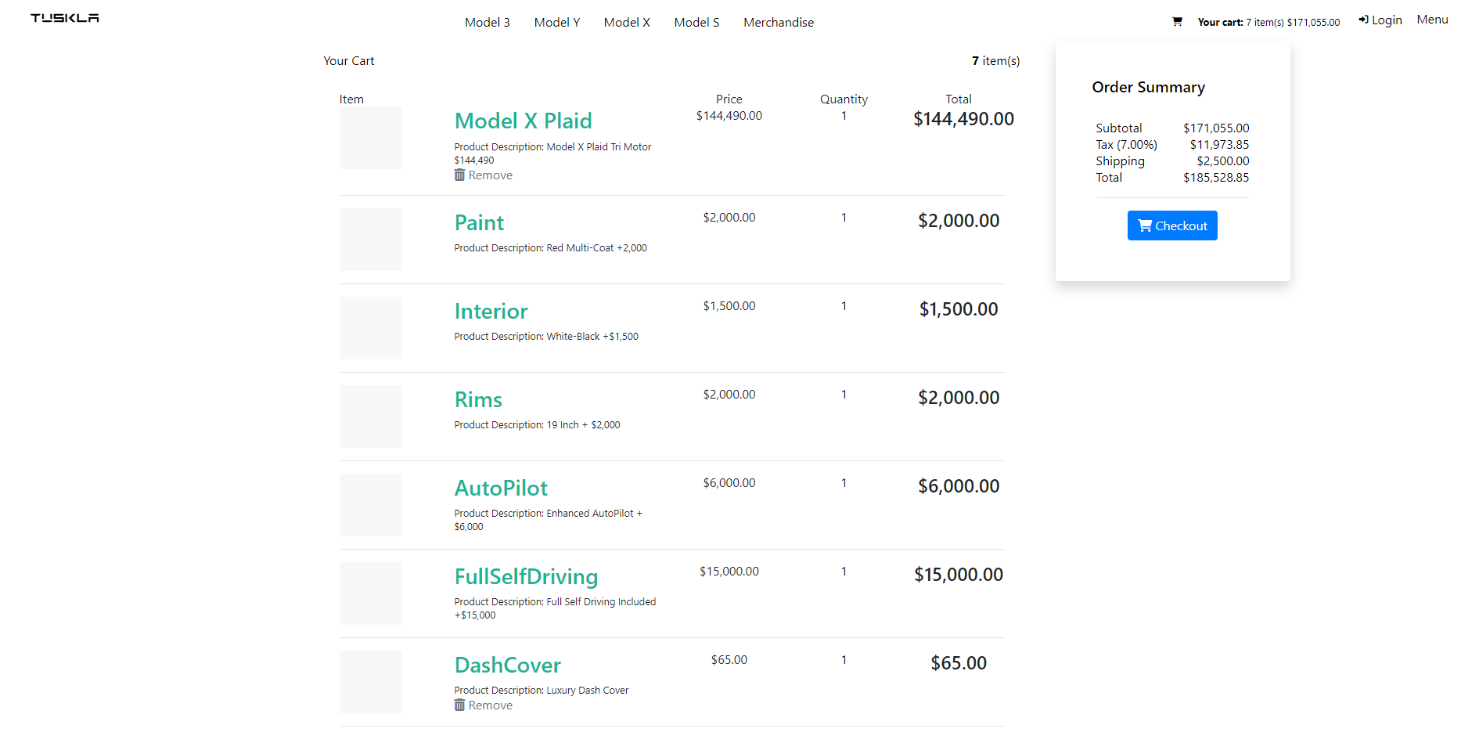
Vehicle AND Merchandise
Improvement Over Tesla

Slide 12
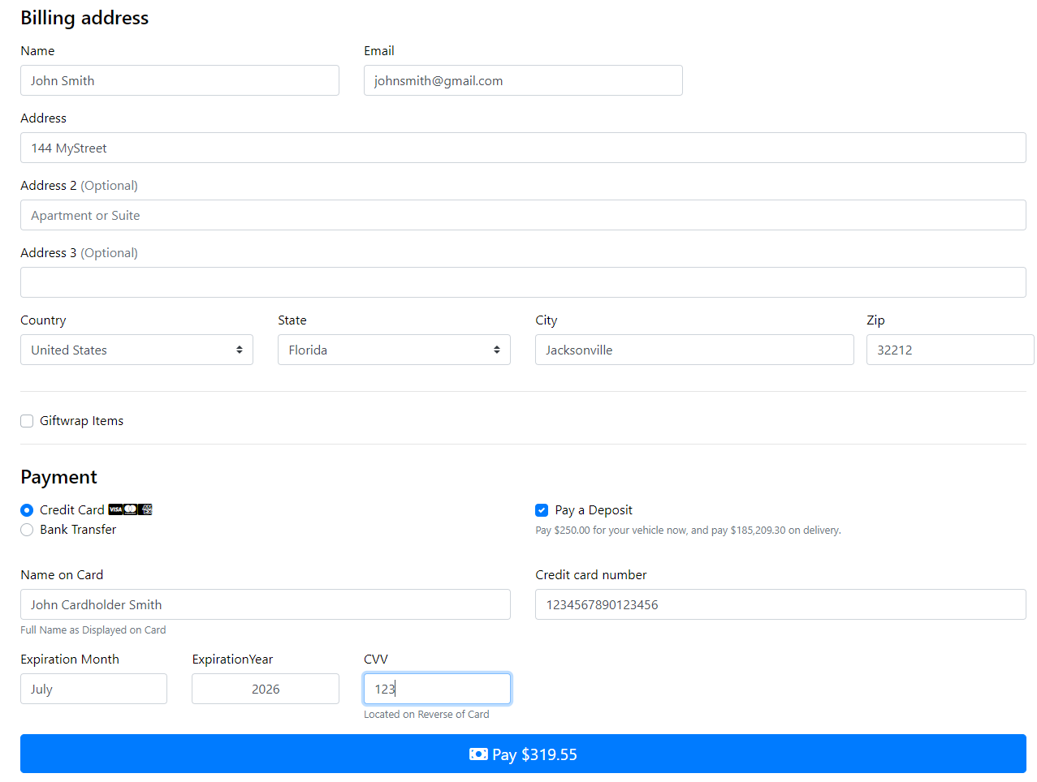
Checkout
Credit/Bank Transfer
Deposit Option
Purchase
Deposit
Merchandise

Slide 13
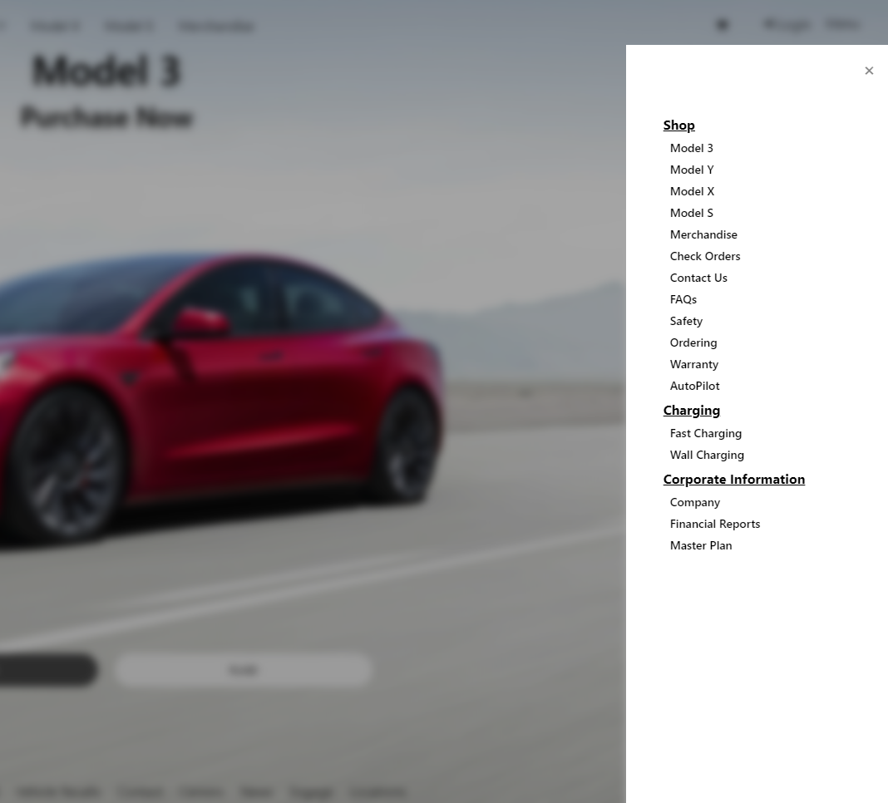
Stakeholder (Course) REQUIREMENTS
Order Display
Company information
FAQ
Administration Functions
ORDER RETRIEVAL
Product information

Slide 14
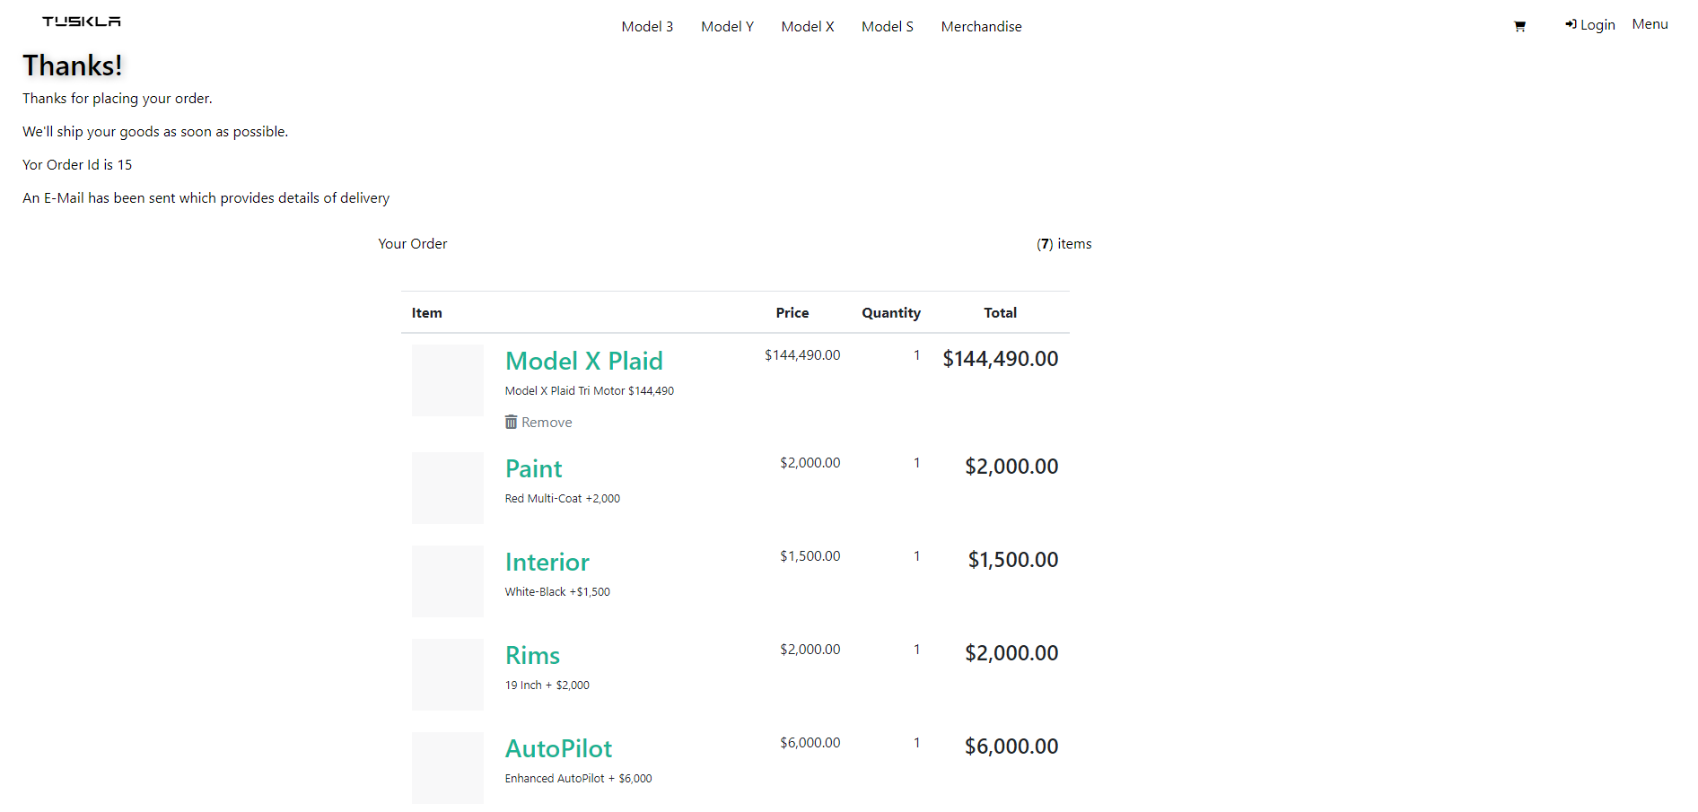
REQUIREMENTS: ORDER DISPLAY
Order Confirmation
Order Summary

Slide 15
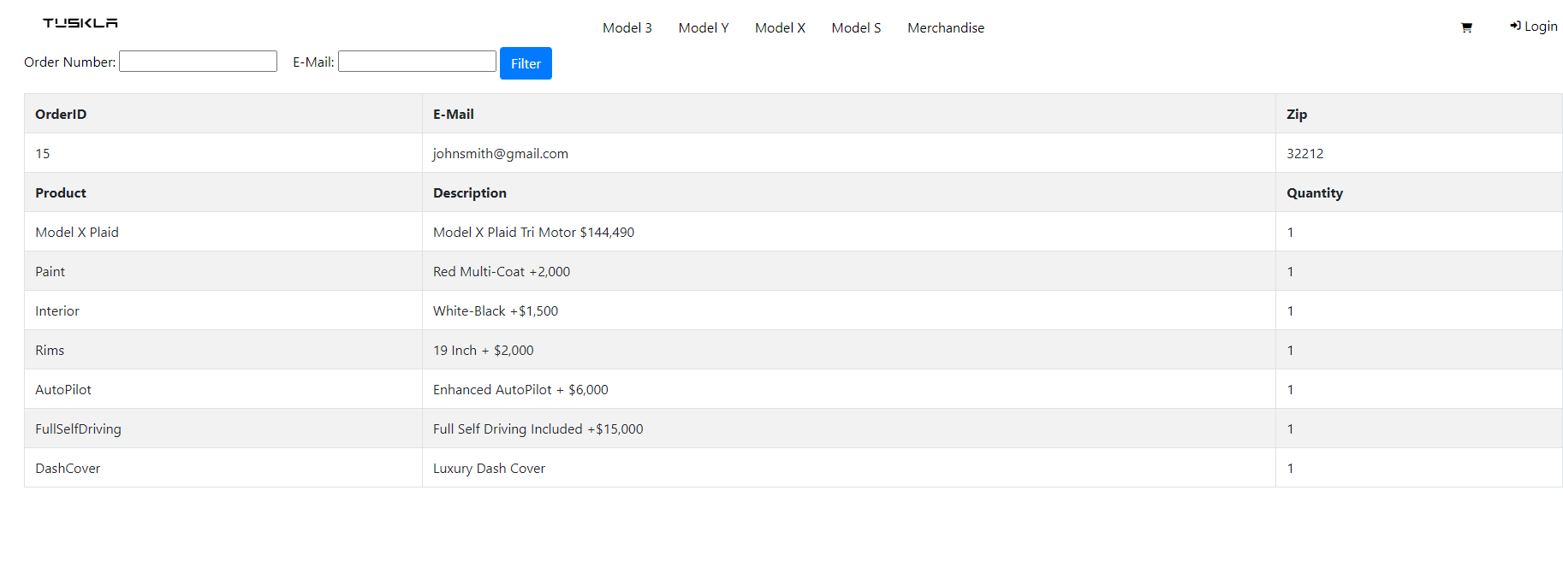
REQUIREMENTS: ORDER RETRIEVAL
Order Search Via ID & Email Address

Slide 16
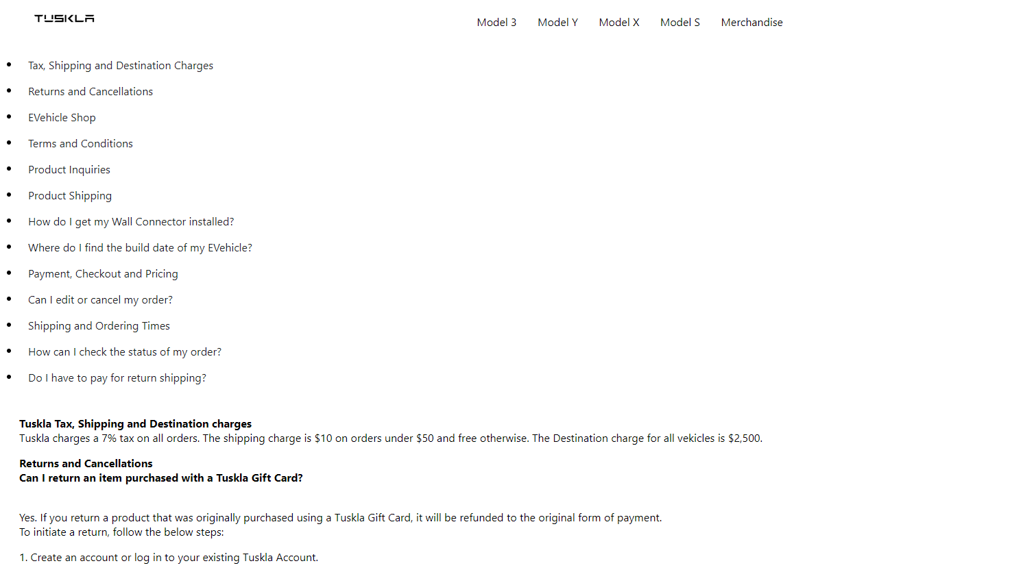
REQUIREMENTS: FAQ

Slide 17
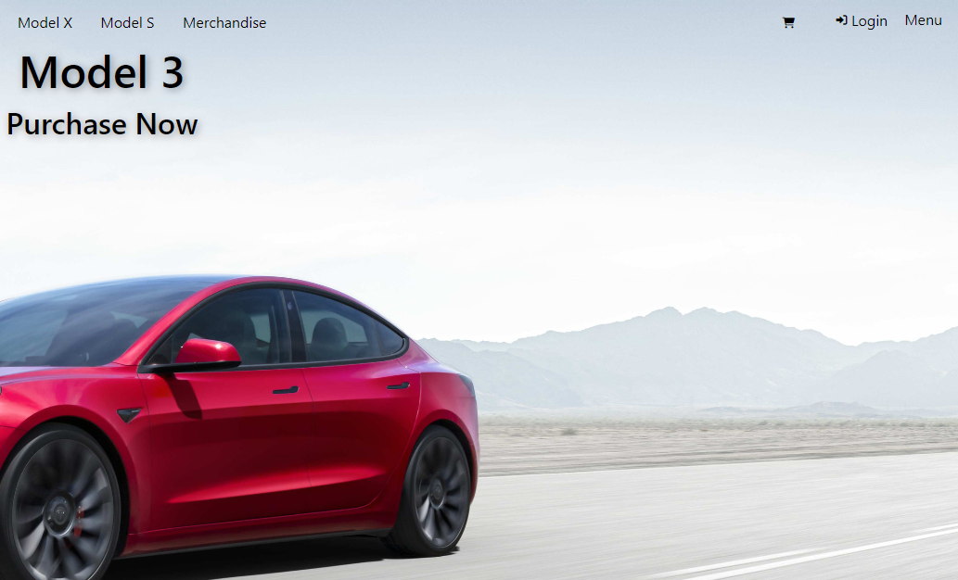
Requirements: Administration
Log in as Administrator

Slide 18
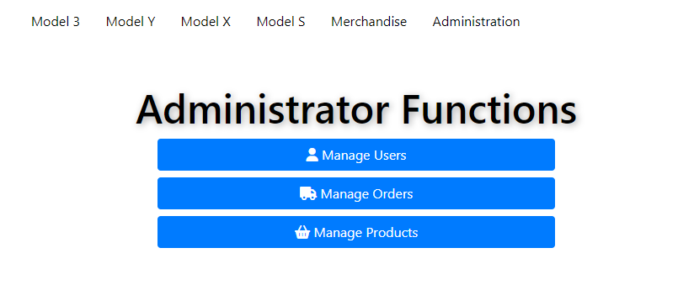
Requirements: Administration
Users
Orders
Products

Slide 19
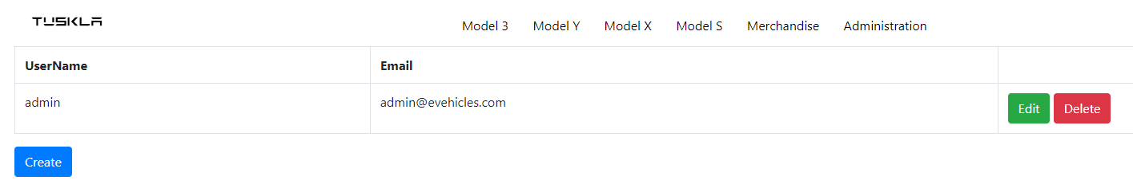
Manage User

Slide 20
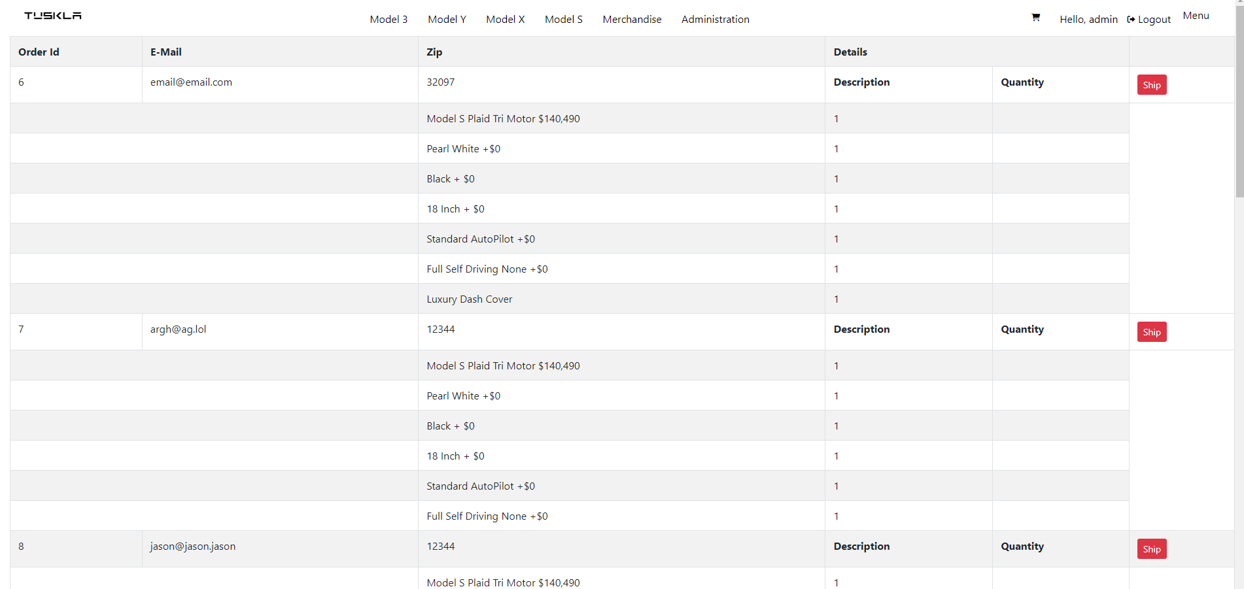
Manage ORDER

Slide 21
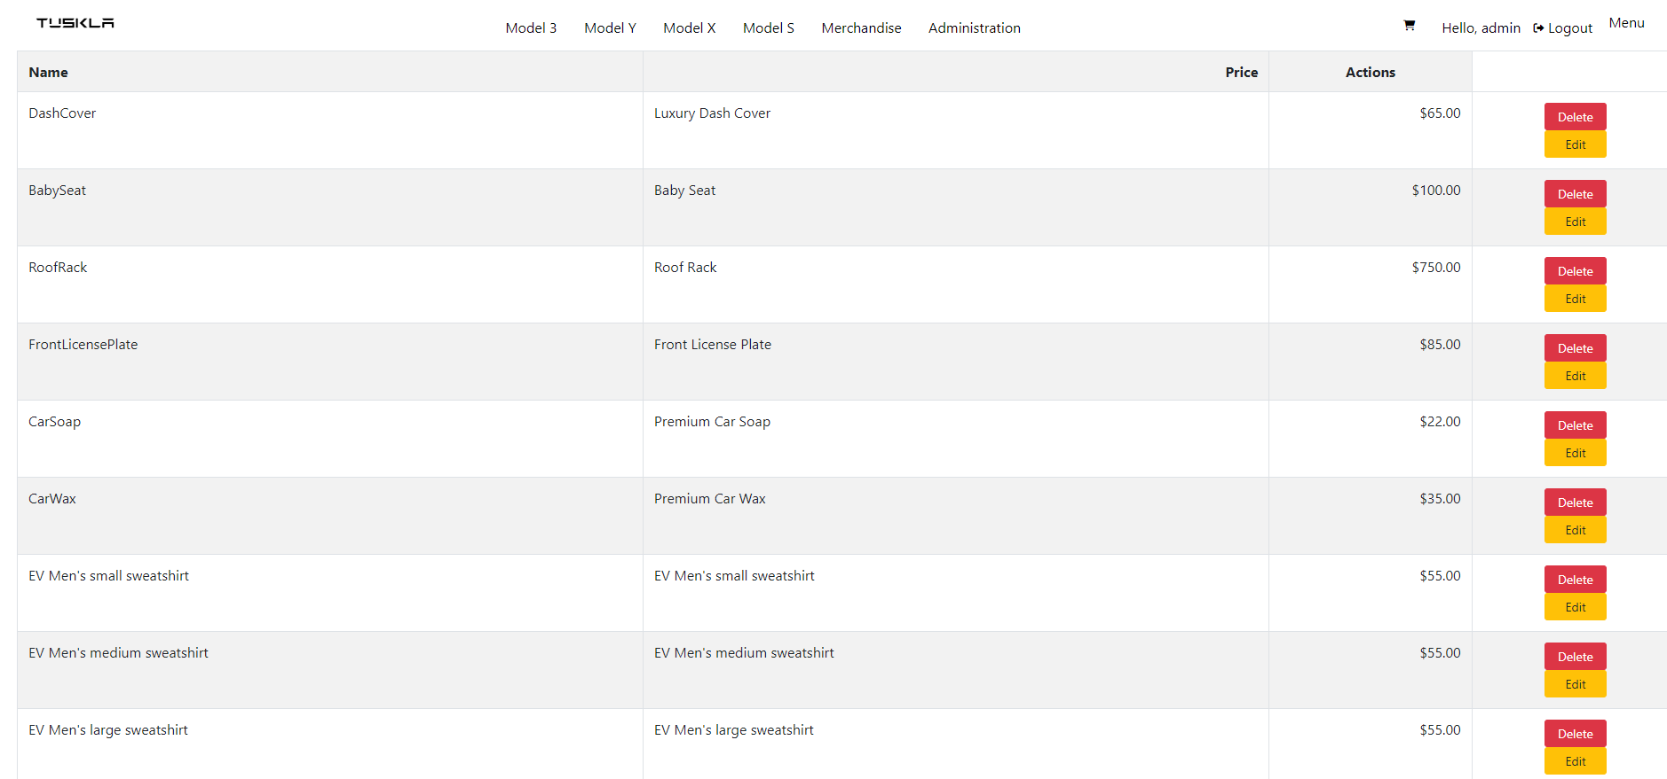
Manage PRODUCTS

Slide 22
Future Work
Account Roles
Cancellation of Orders
Continue Refining UI (Admin)
Increase Support for varied Device Resolutions
Add Support for CSS Extensions (Tested in Edge/Chrome)

Slide 23
Lessons Learned
Team Communication and GitHub were integral to completing the project
“Full Stack Developer” is Hard

Slide 24
Project Goals
We Utilized
GitHub
.NET/HTML/CSS
Third-Party Libraries
Bootstrap
JQuery
MVC Model
Goals
Write an Ecommerce Web Site
Implement a clone of Tesla’s Web Site using the Given Technologies
Utilize sufficient design to create the look and feel of a modern web site.

Slide 25

Questions?

Slide 26
Thank YOU
Open-Source Software Communities
Professor Jethwani
Web Systems Development
Dr. Karthik Umapathy

